Slide 1
Modeling and Performance Evaluation

Slide 2
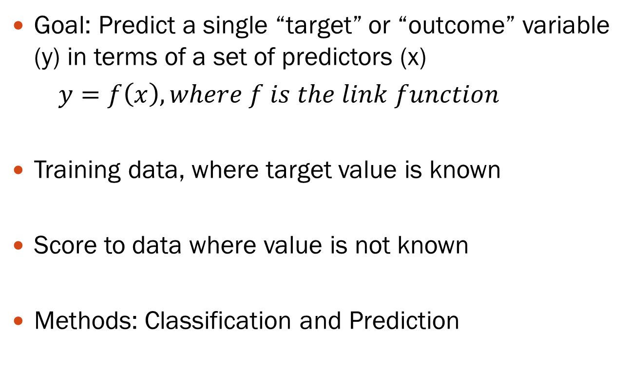
Supervised Learning

Slide 3
Supervised: Classification
Goal: Predict categorical target (outcome) variable
Examples: Purchase/no purchase, fraud/no fraud, creditworthy/not creditworthy…
Each row is a case (customer, tax return, applicant)
Each column is a variable
Target variable is often binary (yes/no)

Slide 4
Supervised: Prediction
Goal: Predict numerical target (outcome) variable
Examples: sales, revenue, performance
As in classification:
Each row is a case (customer, tax return, applicant)
Each column is a variable
Taken together, classification and prediction constitute “predictive analytics”

Slide 5
Steps in Data Mining
Define/understand purpose
Obtain data (may involve random sampling)
Explore, clean, pre-process data
Reduce the data; if supervised DM, partition it
Specify task (classification, clustering, etc.)
Choose the techniques (regression, CART, neural networks, etc.)
Iterative implementation and “tuning”
Assess results – compare models
Deploy best model

Slide 6
Pre-processing Data
Identify the types of variables(Categorical vs. numeric)
Detect outliers
Handle missing values
Determine suitable algorithms for analyzing the data

Slide 7
The Problem of Overfitting
Statistical models can produce highly complex explanations of relationships between variables
The “fit” may be excellent
When used with new data, models of great complexity do not do so well.
Notes:
7

Slide 8
100% fit – not useful for new data
Notes:
8

Slide 9
Overfitting (cont.)
Causes:
Too many predictors
A model with too many parameters
Trying many different models
Consequence: Deployed model will not work as well as expected with completely new data.
Notes:
9

Slide 10
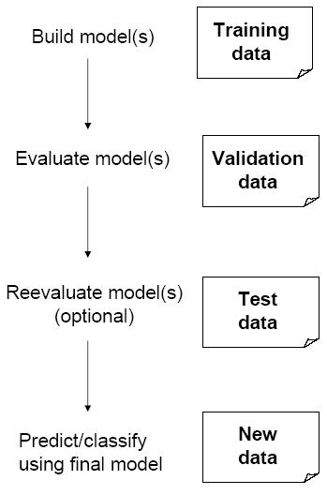
Partitioning the Data
Problem: How well will our model perform with new data?
Solution: Separate data into two parts
Training partition to develop the model
Validation partition to implement the model and evaluate its performance on “new” data
Example: after loading the data “airquality”, we randomly split it into 70% for training and 30% for validation
data(airquality)
split=sample(1:2, nrow(airquality), replace = TRUE, prob=c(0.7, 0.3))
train=airquality[split==1, ]
val=airquality[split==2, ]

Slide 11
Test Partition
When a model is developed on training data, it can overfit the training data (hence need to assess on validation)
Assessing multiple models on same validation data can overfit validation data
Some methods use the validation data to choose a parameter. This too can lead to overfitting the validation data
Solution: final selected model is applied to a test partition to give unbiased estimate of its performance on new data

Slide 12
Why Evaluate?
Multiple methods are available to classify or predict
For each method, multiple choices are available for settings
To choose best model, need to assess each model’s performance

Slide 13
Accuracy Measures (Classification)
Error = classifying a record as belonging to one class when it belongs to another class.
Error rate = percent of misclassified records out of the total records in the validation data
“High separation of records” means that using predictor variables attains low error
“Low separation of records” means that using predictor variables does not improve much on naïve rule

Slide 14
Confusion Matrix
Overall error rate = (25+85)/3000 = 3.67%
Accuracy = 1 – err = (201+2689) = 96.33%
If multiple classes, error rate is:
(sum of misclassified records)/(total records)
201 1’s correctly classified as “1”
85 1’s incorrectly classified as “0”
25 0’s incorrectly classified as “1”
2689 0’s correctly classified as “0”

Slide 15
Cutoff for classification
Most DM algorithms classify via a 2-step process:
For each record,
Compute probability of belonging to class “1”
Compare to cutoff value, and classify accordingly
Default cutoff value is 0.50
If >= 0.50, classify as “1”
If < 0.50, classify as “0”
Can use different cutoff values
Typically, error rate is lowest for cutoff = 0.50

Slide 16
When One Class is More Important
In many cases it is more important to identify members of one class
Tax fraud
Credit default
Response to promotional offer
Detecting electronic network intrusion
Predicting delayed flights
In such cases, we are willing to tolerate greater overall error, in return for better identifying the important class for further attention

Slide 17
Alternate Accuracy Measures
If “C₁” is the important class,
Sensitivity (True Positive Rate) = % of “C₁” class correctly classified
Specificity (True Negative Rate) = % of “C₀” class correctly classified
False Positive Rate (FPR)= 1-Specificity
False Negative Rate (FNR)= 1-Sensitivity
False-positive predictive value (FPPV) = % of predicted “C₁’s” that were not “C₁’s”
False-negative predictive value(FNPV) = % of predicted “C₀’s” that were not “C₀’s”

Slide 18
Alternate Accuracy measures (2)
Sensitivity = (201)/(201+85) = 70.28%
Specificity =2689/ (25+2689) = 99%
FPPV=25/(201+25)=11.06%
FNPV=85/(85+2689)=3.06%

Slide 19
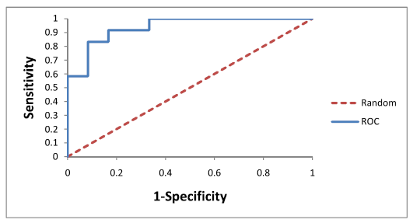
ROC Curve
The higher the area under the curve (AUC), the better the predictive performance.
The AUC value lies between 0.5 (50%) to 1 (100%) where 0.5 denotes a bad classifier and 1 denotes an excellent classifier.

Slide 20
Oversampling

Slide 21
Rare Cases
Asymmetric costs/benefits typically go hand in hand with presence of rare but important class
Responder to mailing
Someone who commits fraud
Debt defaulter
Often we oversample rare cases to give model more information to work with
Typically use 50% “1” and 50% “0” for training

Slide 22
An Oversampling Procedure
Separate the responders (rare) from non-responders
Randomly assign half the responders to the training sample, plus equal number of non-responders
Remaining responders go to validation sample
Add non-responders to validation data, to maintain original ratio of responders to non-responders.
Let p be the proportion of non-responders and n1 the number of responders in the original data, the number of non-responders in the validation is n0v= p*0.5*n1/(1-p)
Randomly take test set (if needed) from validation

Slide 23
Oversampling with R
# Assuming 'your_data' is your original dataset (generated below)
set.seed(123)
your_data=cbind(rbinom(1000,1,0.05),rnorm(n=1000,m=35,sd=4),rnorm(n=1000,m=1500,sd=500))
colnames(your_data)=c("Class", "Age","Salary")
your_data=as.data.frame(your_data)
# Separate responders (class 1) from non-responders (class 0)
responders <- subset(your_data, Class == 1)
non_responders <- subset(your_data, Class == 0)
# Calculate the number of responders and non-responders
num_responders <- nrow(responders)
num_non_responders <- nrow(non_responders)
# Randomly assign half of responders to training sample
set.seed(123)
train_responders_indices <- sample(1:num_responders, size = num_responders / 2)
train_responders <- responders[train_responders_indices, ]
# Select equal number of non-responders for training
train_non_responders <- non_responders[train_responders_indices, ]
# Remaining responders go to validation sample
validation_responders <- responders[-train_responders_indices, ]
non_responders =non_responders[-train_responders_indices, ]
num_non_responders =nrow(non_responders)
# Calculate how many non-responders are needed to maintain the original ratio
num_validation_non_responders <- nrow(validation_responders) * (num_non_responders / num_responders)
# Randomly sample non-responders for validation data to maintain original ratio
validation_non_responders <- non_responders[sample(1:num_non_responders, size = num_validation_non_responders), ]
# Combine training data (responders and non-responders)
train_data <- rbind(train_responders, train_non_responders)
# Combine validation data (responders and non-responders)
validation_data <- rbind(validation_responders, validation_non_responders)

Slide 24
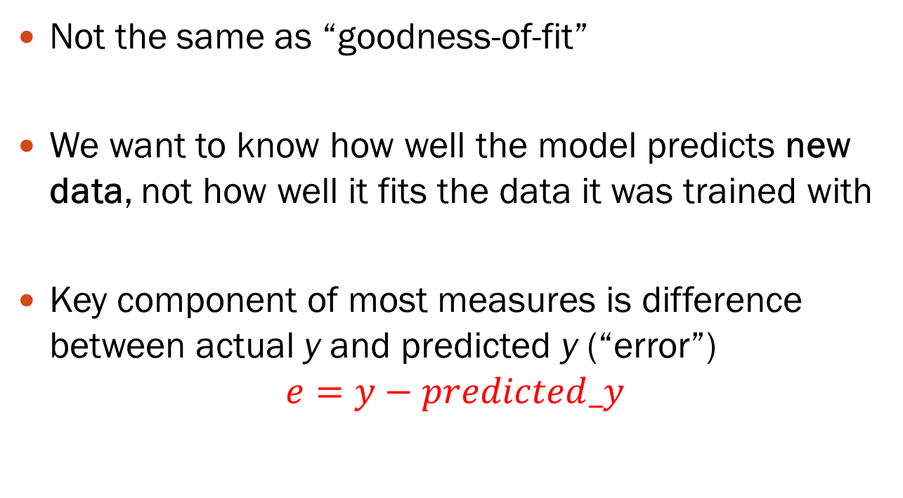
Measuring Predictive error

Slide 25
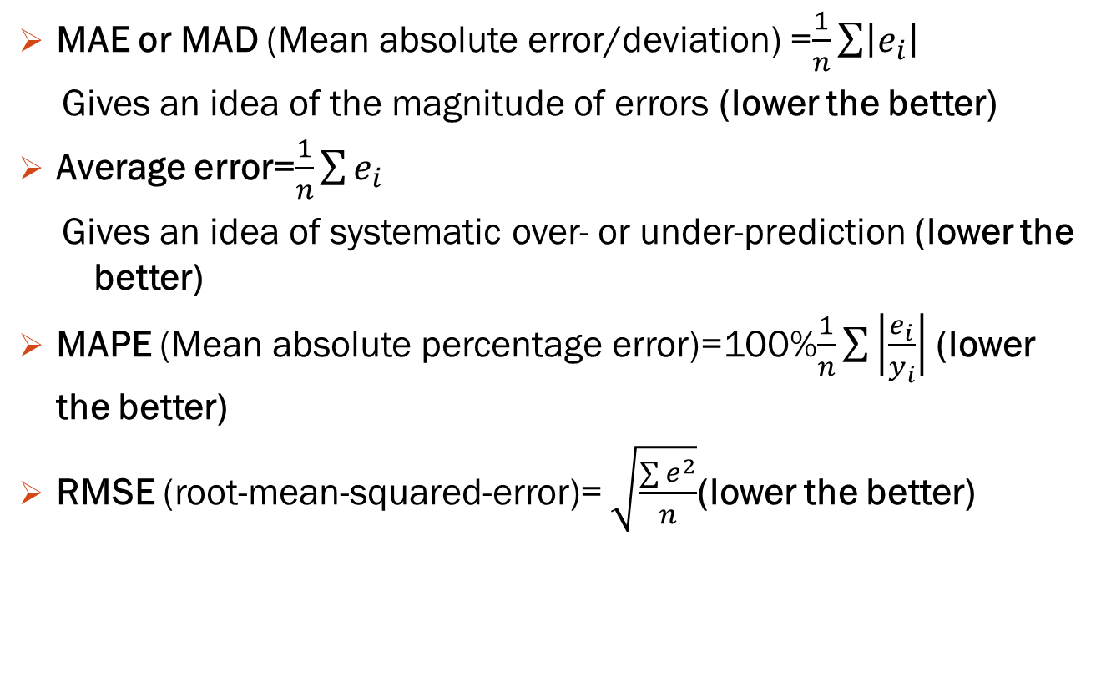
Some measures of error or accuracy

